Slide 1
Parent Information Session Juniors
Rikako Karaki: School Counselor
Chris Arrington: School Counselor
Karen Gill: College and Career Counselor
Osceola County School for the Arts

Slide 2
MEET YOUR COUNSELORS
Mr. Arrington: Band, Orchestra, Vocal
Ms. Karaki: Creative Writing, Technical Theatre, Dance, Drama & Visual Arts
Ms. Gill: College and Career Counselor

Slide 3
What you should know?
Requirements for graduation in 2023.
How to help them research college and careers on Xello
How to help them with college applications
How to help with essays and resumes
How to help get the financial support needed
Junior year is for research and senior year is for action.

Slide 4
GRADUATION REQUIREMENTS
LANGUAGE ARTS - 4 CREDITS
MATHEMATICS – 4 CREDITS(Algebra/Geo)
SCIENCE – 3 CREDITS(Biology, 2 rigorous)
SOCIAL STUDIES – 3 CREDITS
WORLD HISTORY – 1
AMERICAN HISTORY – 1
AMERICAN GOV’T – .5
ECONOMICS - .5

Slide 5
GRADUATION REQUIREMENTS
Physical Education – Pers. Fitness/Team Sports-1
World Languages/Elective– 2
1 Online Class-FLVS, Valencia
To get the performing arts endorsement on your diploma you must have 8 performing arts credits in your major area of study. (This includes the 1 State credit for Performing Arts)
28 TOTAL CREDITS FOR GRADUATION

Slide 6
Assessment Requirements for Graduation 2023
FSA Reading- level 3 or above
Algebra 1 – pass class, pass EOC for credit, 30% of grade
Geometry – pass class- EOC is 30% of grade
Biology-pass class- EOC is 30% of grade
U.S. History-pass class- EOC is 30% of grade

Slide 7
Assessment Requirements 2
No Biology EOC if students take AP Biology
No US History EOC if students take AP or DE US History

Slide 8
Grade Point Average
Weighted GPA
Grade=Quality Pts.
AP & D E Honors
A = 5.0 4.5
B = 4.0 3.5
C = 3.0 2.5
D = 2.0 1.5
Unweighted GPA
Grade=Quality Pts.
A = 4.0
B = 3.0
C = 2.0
D = 1.0
F = 0.0

Slide 9
Senior Year
Students will have many ups and downs
Students may need about +$1000 to cover all expenses of high school and the college process
Yearbook
Cap and Gown
College application fees
Test fees
Housing deposits
Enrollment deposits
Prom
Universal’s Senior Graduation event

Slide 10
What you should do?
Remind them they still have to get good grades and study in their Junior and Senior year. COMPLETE ONLINE CLASS!
Keep communication open
Listen to what they want – about college
Listen for uncertainty, lack of confidence etc.
Help them to be realistic and boost confidence
Take them to visit colleges; virtual visits
Remind them about tests and deadlines – help them make a calendar and keep a college folder
Be prompt with any pieces you have to complete i.e. this year’s tax returns to use for next year’s FAFSA

Slide 11
When you can help
Now – help student do research about careers and determine the selection criteria for college.
Career Research- Xello
College selection criteria includes:
Major /Degrees offered
Location (in- state vs. out of state)
Size (how do you learn?)
Financial aid opportunities / cost
Admissions requirements
Good college website for parents – Big Futures at Collegeboard.org

Slide 12
Tips
Understand what the college is looking for: Have a plan B.
Be sure all parts of the application are complete and submitted; extra pair of “eyes”
SPELLING and GRAMMAR are important!!!!!
Proofread essays and have someone else proofread before submit
Treat every application like your first choice
Meet your deadlines!
Subscribe to Ms. Gill’s REMIND texts for information AND READ THEM!

Slide 13
Tips
Attend college fairs: make contact with admissions personnel
Research admissions and scholarship requirements
NO SCHOOL IS FOR EVERYBODY AND EVERYBODY IS NOT FOR EVERY SCHOOL. Have REACH and MATCH schools.
Take process seriously but keep things in perspective: there are over 4,000 colleges in the U.S.
Colleges look for rigorous classes and upward trends, quality of involvement, strong test scores a predictor of how may do you 1st year of college

Slide 14
During the Summer
Visit colleges either in person or via internet www.collegeview.com for selection
www.ecampustours.com for viewing colleges.
Allow student to be a part of college summer programs
Allow student to get an internship (paid or unpaid)
Get all information together for application process in September

Slide 15
Senior Year Actions
September
Sign up for another entrance test
Help apply to colleges in Florida
Come to parent night events
If going Out of State – go to those college information sessions – usually in Orlando
Check Focus monthly to keep up with their grades.
October
Remind them to order transcripts via Xello in a timely manner
Sign the residency affidavits on the Florida college applications
Take them to open houses
Fill out FAFSA(fafsa.gov) and FLORIDA FINANCIAL AID (Bright Futures) www.floridastudentfinancialaid.org

Slide 16
Senior Year Actions
November
Go to the financial aid night near you.
Help them start applying for out of state colleges
Start on scholarship applications. Give us ample time to fill out recommendations.
December
Make sure they have completed their out of state applications by the end of the month
Help them acquire any missing paperwork the FL colleges say is missing.

Slide 17
Senior Year Actions
January
Remind students to check for scholarships
Senioritis may set in – check Focus !
February
Keep reminding students to look for scholarships
Early decision letters will be coming this month or before.
Talk to your child about acceptances and rejections

Slide 18
Senior Year Actions
March
You will have to help with housing applications and deposits
You will have to help with acceptance deposits
Continue to remind about scholarships
April
Work together to make the final decision on the college based on the financial aid package they offer
Last reminder about scholarships

Slide 19
Senior Year Actions
May
Students should have plans set at this point – must decide by May 1st!
They will need to pick up cap and gown
They may be heading off in June – collect checklists of what they will need at college and start getting those items.
Go to their graduation and smile! You’ve earned it!

Slide 20
How do I make an appointment with the counselor?

Slide 21
Schedule an appointment with your School Counselor

Slide 22
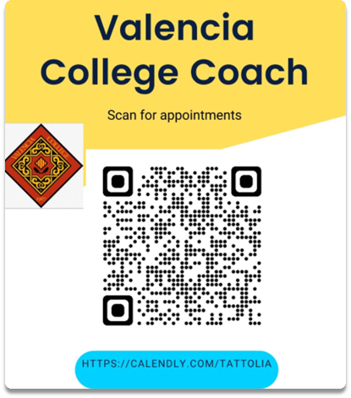
VALENCIA COLLEGE TRANSITION COACH
Ms. Amanda McRae

Slide 23
Xello
Xello is a free tool that all Osceola County School for the Arts student have. You can take career assessments, research careers and colleges, use it for goal setting, upload and save documents and so much more!

Slide 24
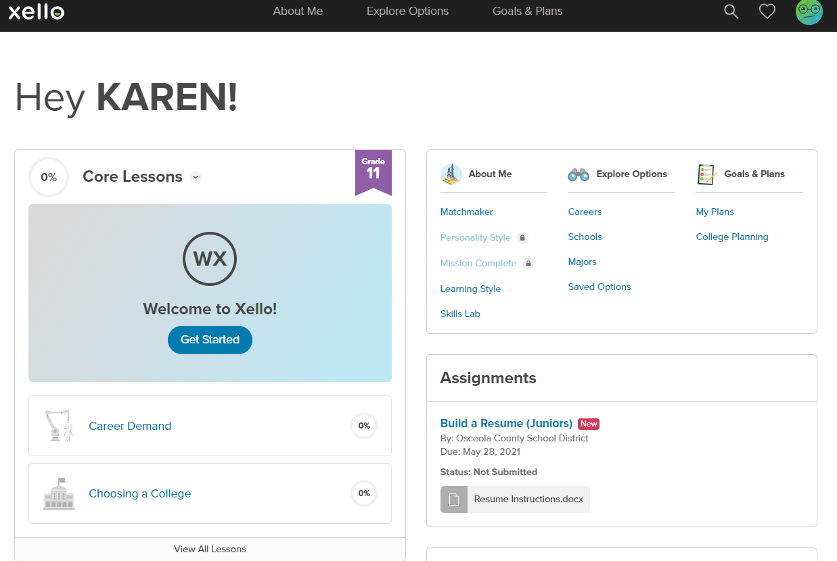
Xello Landing Page

Slide 25
Complete Xello lessons

Slide 26
Xello-Resume No resume = No Letter of Recommendation

Slide 27
Xello
Transcripts will be sent electronically through Xello so it is imperative that student input the college information correctly for counselor to fill out their end of the documents.

Slide 29
Scholarship Money
https://www.raise.me/join/osceola-county-school-of-arts

Slide 30
Scholarship Money

Slide 31
Remind-Ms. Gill 2023

Slide 32
Questions?

